Slide 1
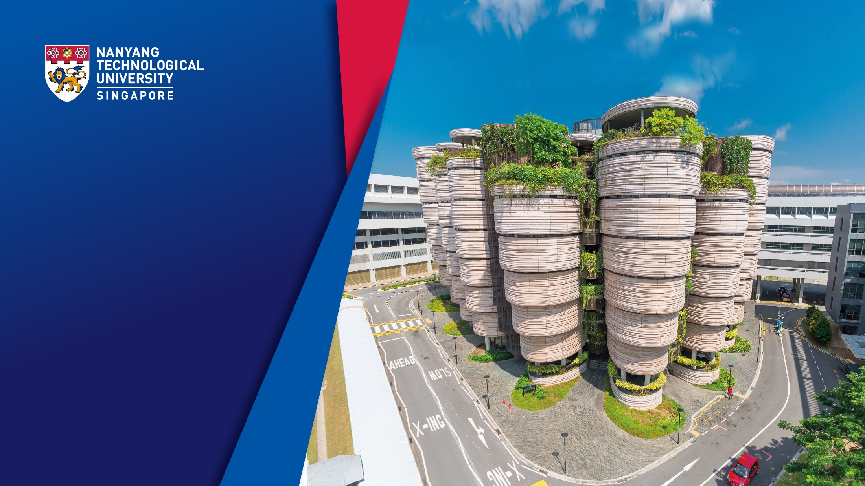
Innovative Design and Optimization of Arithmetic Circuits in Quantum Computing
Siyi Wang siyi002@e.ntu.edu.sg School of Computer Science and Engineering

Slide 2
Overview
01
02
03
02
03
Introduction
Previous Work
Quantum Addition
04
02
03
05
06
Quantum Division
Future Plan
Q&A

Slide 3

01
Introduction

Slide 4
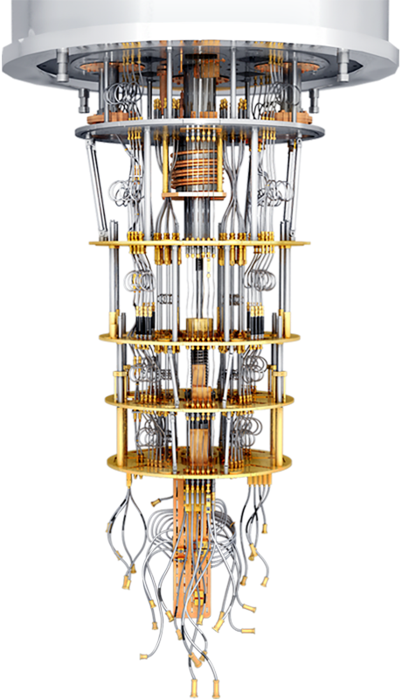



Quantum Computer
➔
Introduction
Quantum computers are set to revolutionize multiple application domains by offering algorithmic speed-up over the best-known classical algorithms.
Finance
Drug Discovery
Cryptography

Slide 5
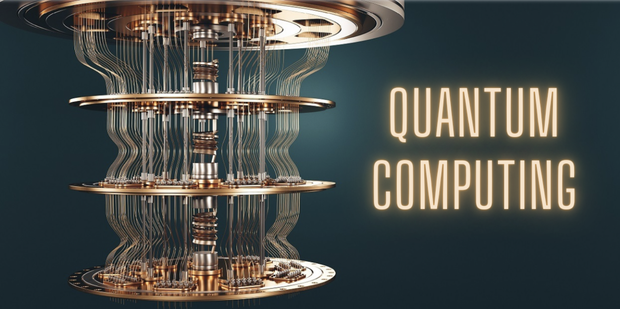
➔
Introduction
Quantum arithmetic has gained extensive attention since it determines:
the computational capability
the overall cost of numerous quantum algorithms
the overall cost of large-scale quantum circuits.
Quantum Adder
Quantum Divider
...
Quantum Multiplier
Quantum
Arithmetic

Slide 6
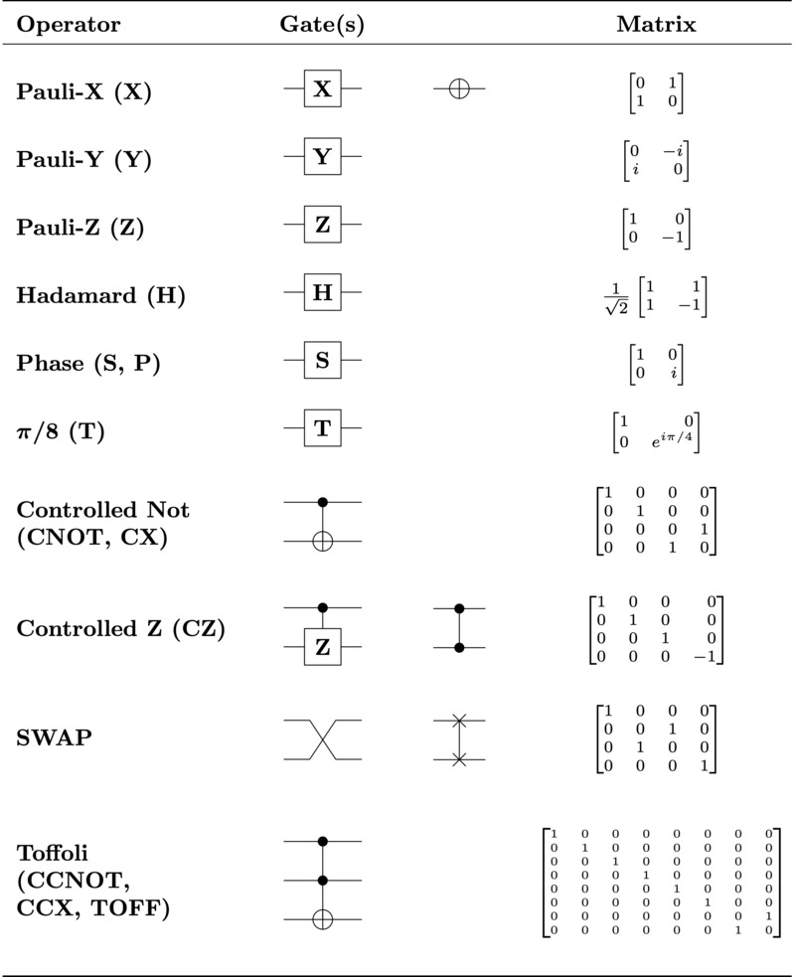
➔
Basic quantum logical gates
Here is a concise overview of basic quantum logic gates, including corresponding quantum circuits as well as unitary matrices.

Slide 7


➔
Challenge and Motivation
Challenge:
Motivation:
Special Quantum circuit properties
Efficient quantum mathematical calculations.
Accelerate the advancement of quantum computing revolution.
In quantum computing, the exploration and improvement of quantum arithmetic circuits efficiency promise more efficient quantum mathematical calculations. Moreover, it also significantly accelerate the advancement of the quantum computing revolution.

Slide 8

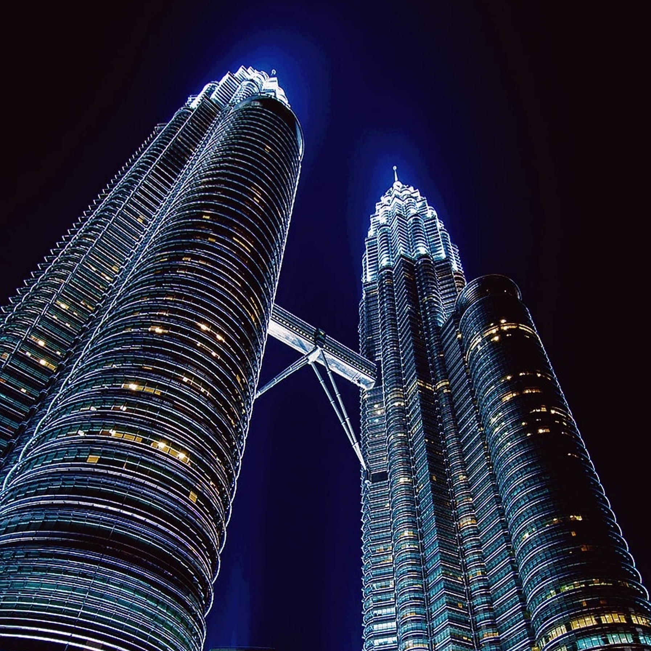

➔
Research Objectives
The main objectives of the research include:
Apply innovative optimization strategies.
Integrate classical computing strategies.
Optimize quantum arithmetic circuits.

Slide 9
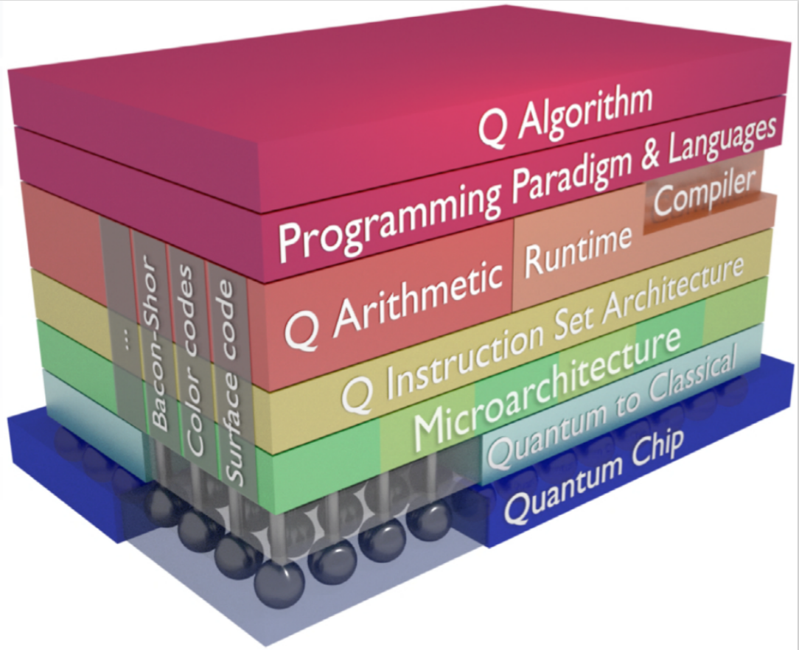
➔
Evaluation Metrics
The evaluation of the quantum system is conducted comprehensively using various metrics.
Quantum Volume
CLOPS
Layer Fidelity
Error per Layered Gate (EPLG)
https://research.ibm.com/blog/quantum-metric-layer-fidelity
Architecture of quantum system

Slide 10
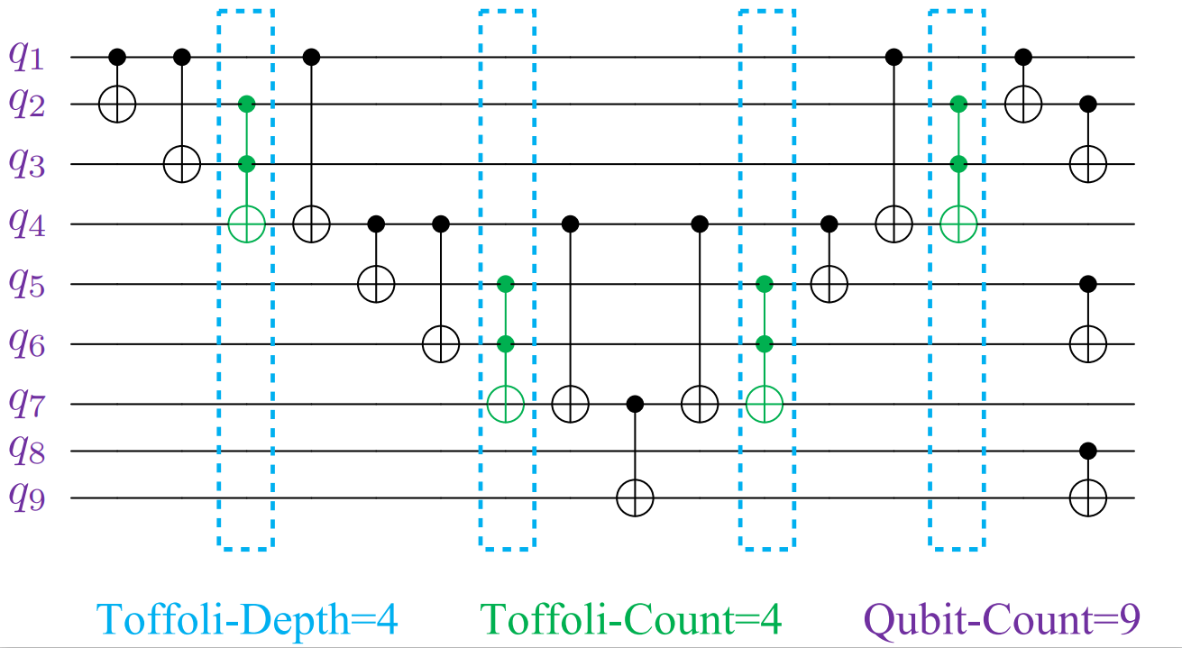
➔
Evaluation Metrics
The three main metrics are outlined as follows:
Toffoli-Depth.
Time complexity
Depth of Toffoli layers
Toffoli-Count
Resource consumption
The total count of Toffoli
Qubit-Count
Size
The total number of qubits

Slide 11
➔
Contributions
Quantum Applications of Classical Higher Radix Strategy.^{[5]}
Quantum Applications of Classical Ling Structure.^{[6]}
Quantum Applications of Kogge-Stone Tree.
Quantum Applications of Non-restoring Division.^{[7]}
Comprehensive Evaluation and Comparison.

Slide 12

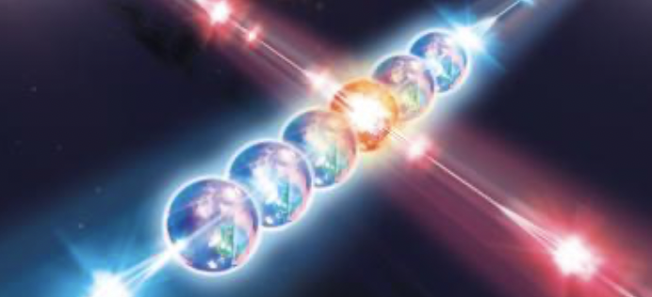

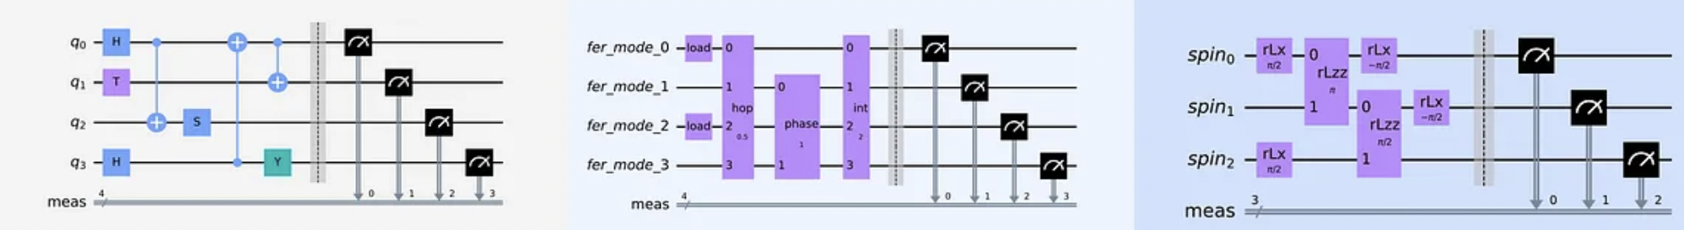
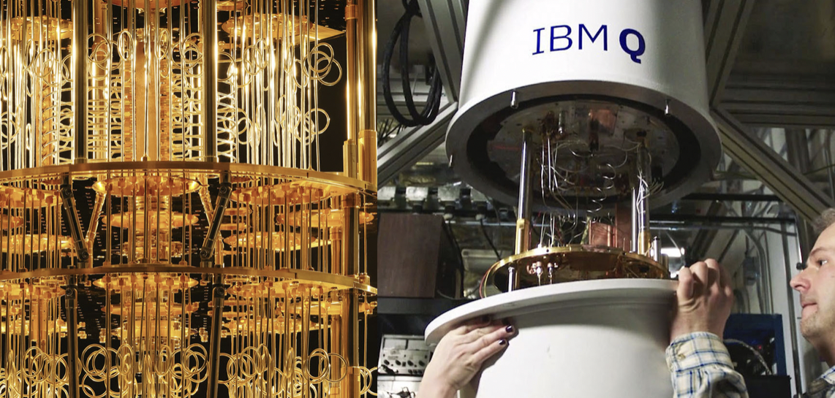
➔
Research Flow
Design
Programming
Verification
Quantum
Simulator
...
Quantum
Hardware

Slide 13
02
Previous Work

Slide 14
➔
Previous Work on Quantum Adders
The relevant research can be divided into the following three categories:
Quantum Ripple Carry Adder
Types: VBE RCA^{[1]}, Cuccaro RCA^{[2]}, ...
Cost: Low T-Count, Lowest Qubit Count
Quantum Carry Look-ahead Adder
Types: Draper In-place CLA^{[3]}, Draper Out-of-place CLA^{[3]}, ...
Cost: Lowest T-Depth, Highest Qubit Count
Qubit-based Adder
Type: Gidney Adder^{[4]}, Quantum Fourier adder^{[8]}, ...
Cost: Lowest T-Count, Low Qubit Count

Slide 15
➔
Previous Work on Dividers
The relevant research can be divided into the following two categories:
Classical Division
Slow Division: Restoring Divider, Non-restoring Divider, SRT Divider^{[9][10]}
Fast Division: Newton–Raphson, Goldschmidt^{[11][12]} ...
Quantum Division
Quantum Slow Division: Khosropour Divider^{[13]},Thapliyal Divider^{[14][15]} ...
Quantum Fast Division: Mathias Divider^{[16]}, Gayathri Divider^{[17][18]} ...
Previous Limitation

Slide 16
03
Quantum Addition

Slide 17
Study 1
Quantum Higher Radix Adder^{[5]}
Wang, S., Baksi, A. & Chattopadhyay, A. A Higher radix architecture for quantum carry-lookahead adder. Sci Rep 13, 16338 (2023). https://doi-org.remotexs.ntu.edu.sg/10.1038/s41598-023-41122-4

Slide 18
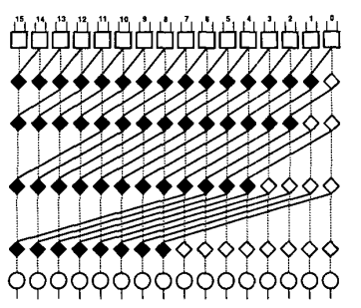
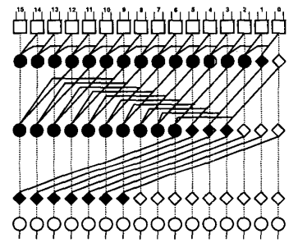
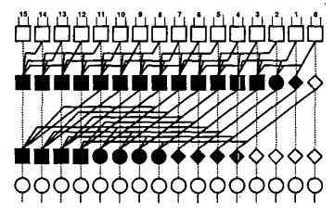



What is Higher radix strategy？
Radix：maximum number of bits that basic units can process simultaneously.
Using the higher radix strategy reduces T-depth and overall time cost.
$$4$$
$$3$$
$$2$$
Radix 2
Radix 3
Radix 4

Slide 19
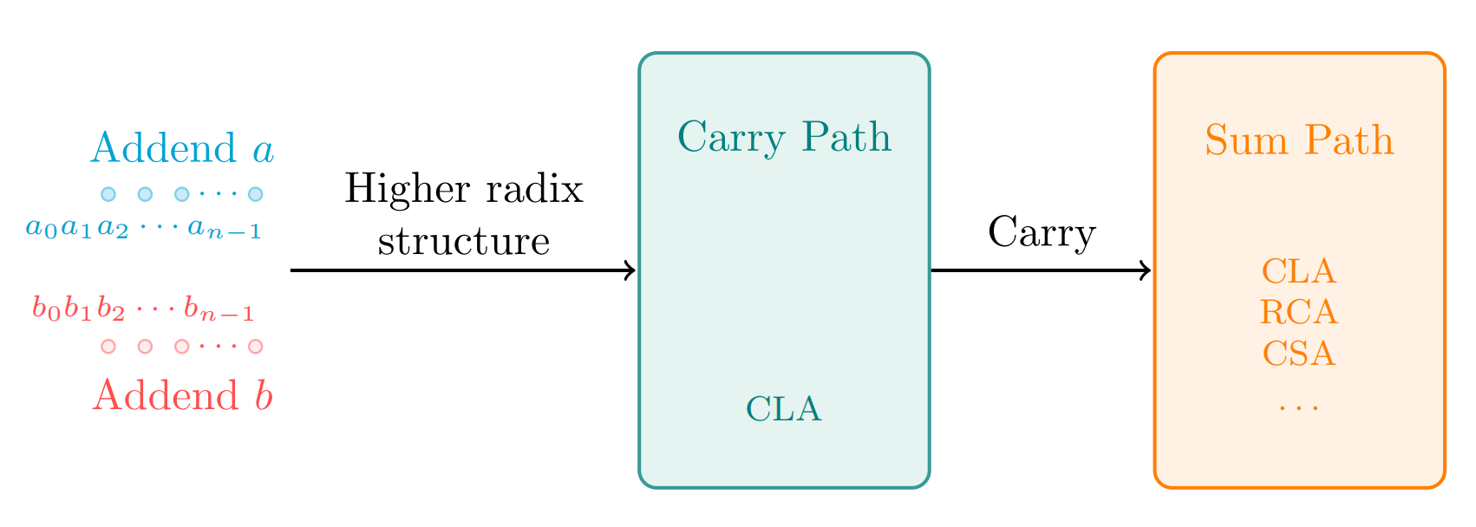
Methodology
A general framework of higher radix adder.

Slide 20
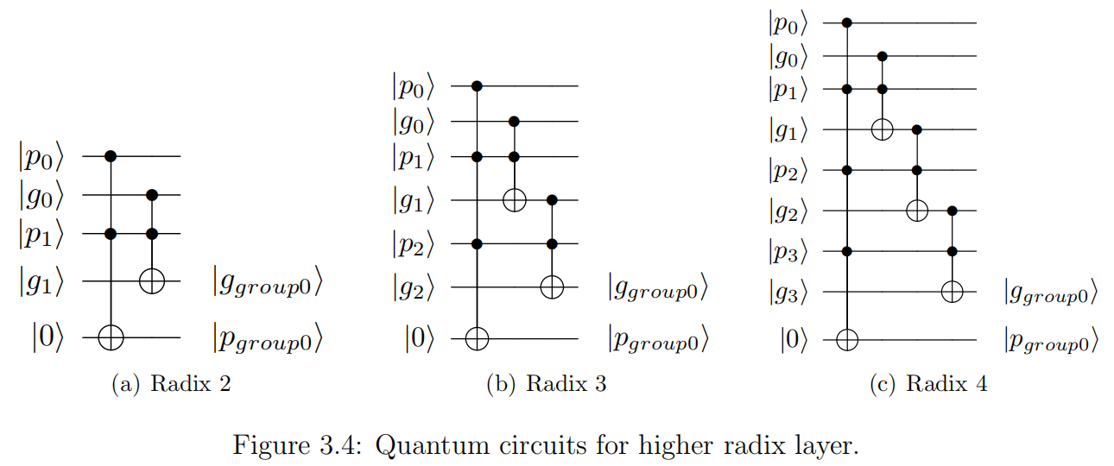
Step 1
Higher Radix Layer

Slide 21
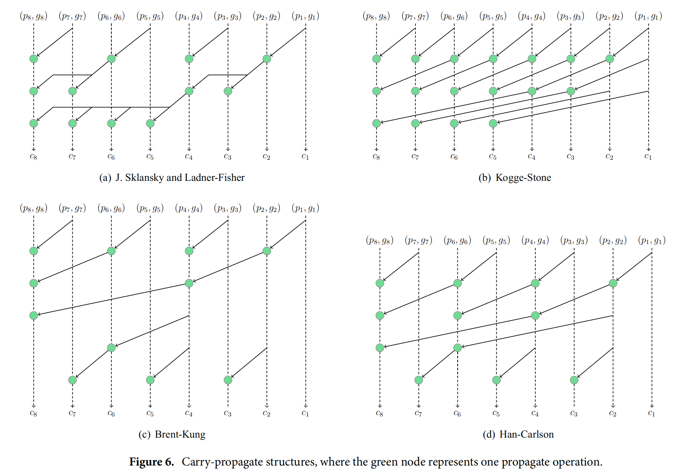
Step 2
Carry Path
✓

Slide 22
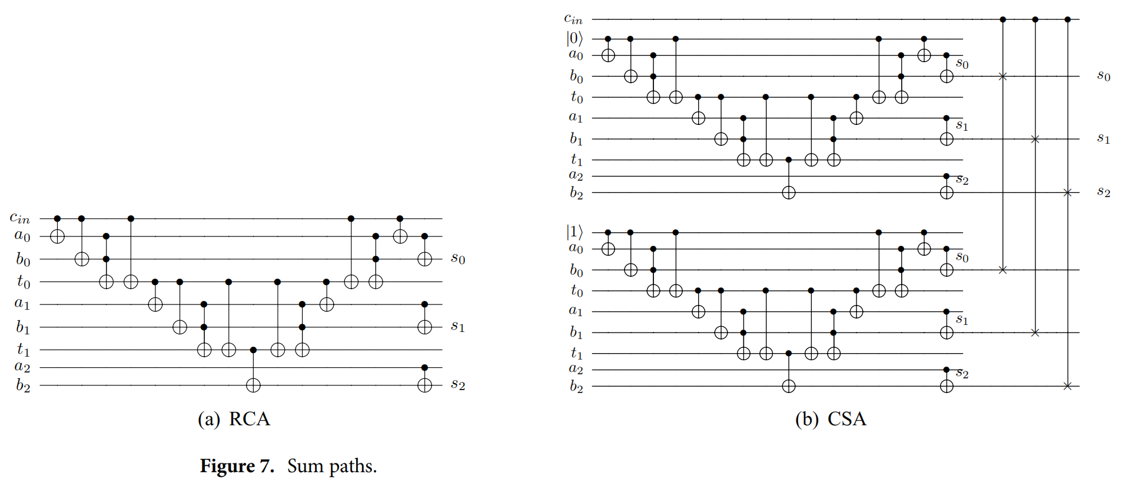
Step 3
Sum Path
✓

Slide 23
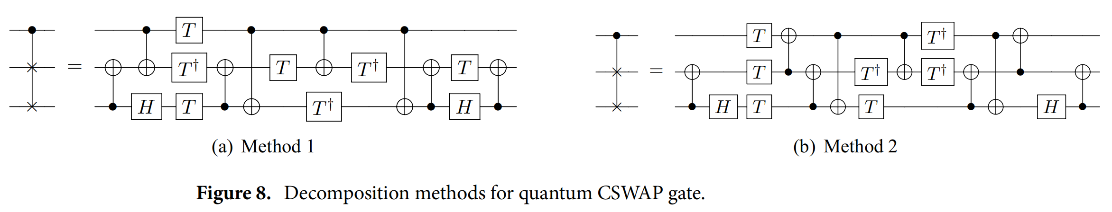
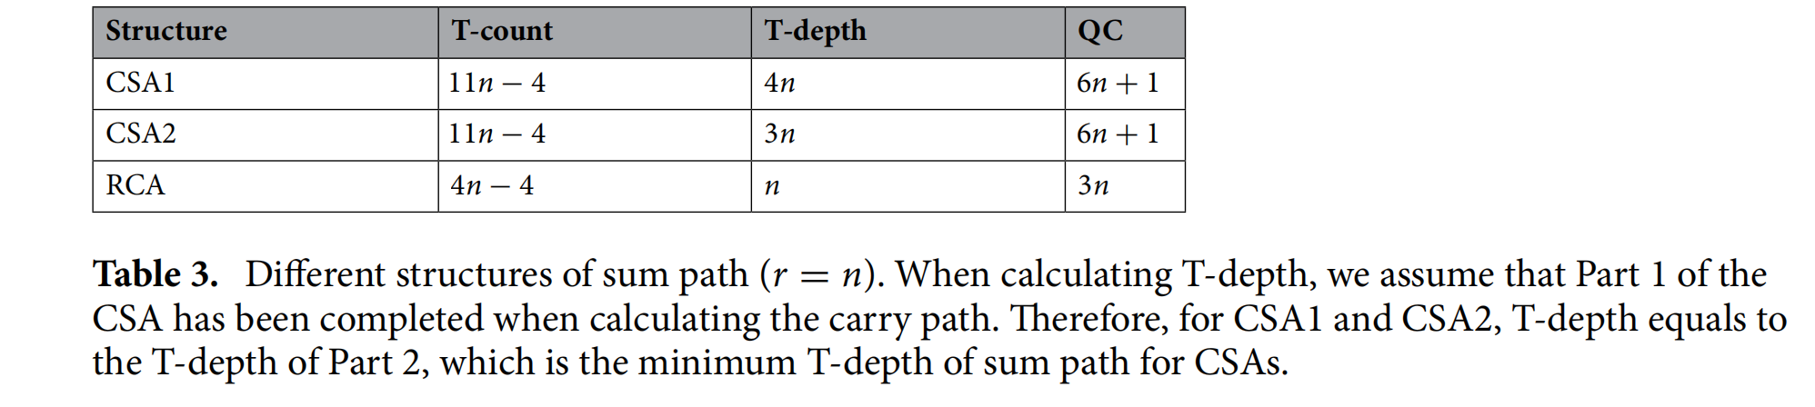
✓

Slide 24
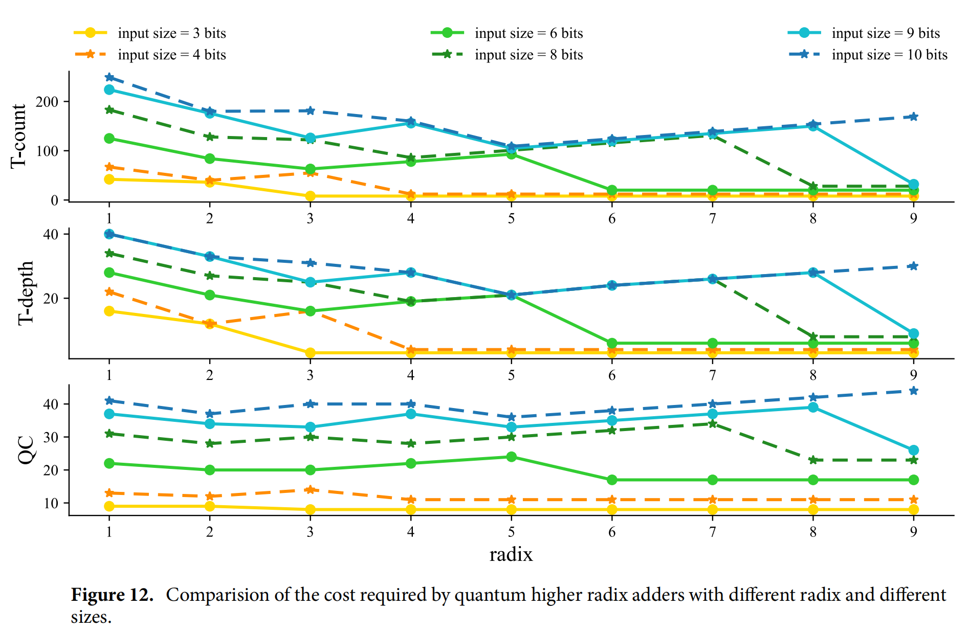
Results and Discussions

Slide 25
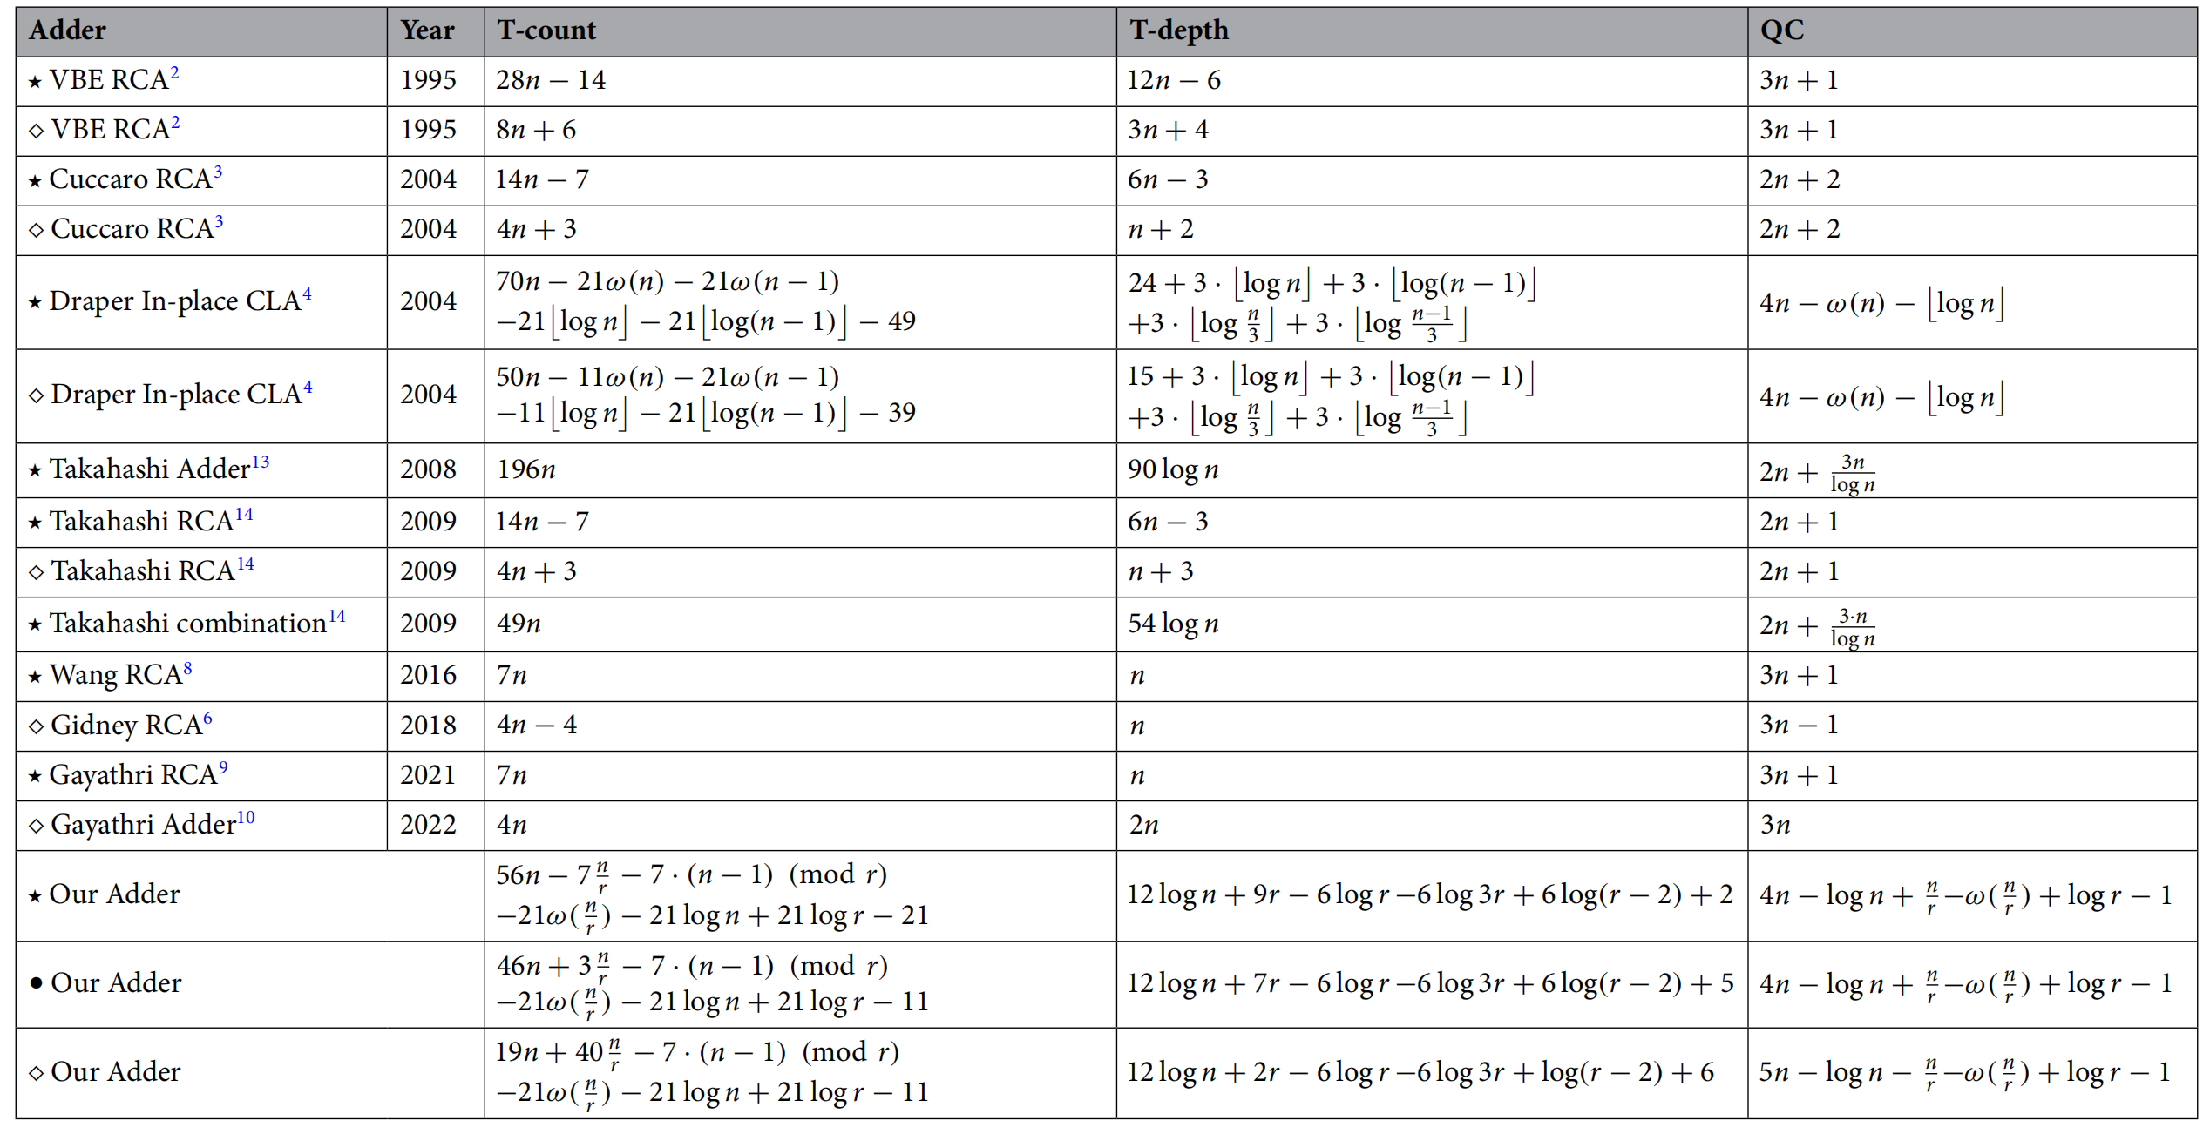
Results and Discussions

Slide 26
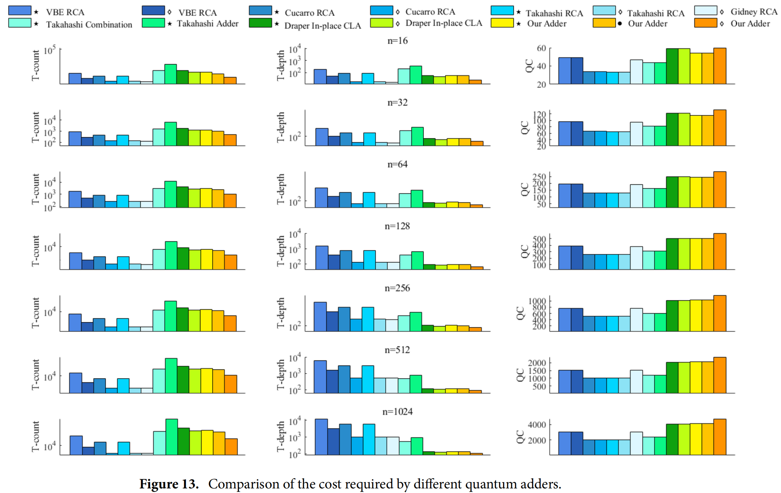

Slide 27
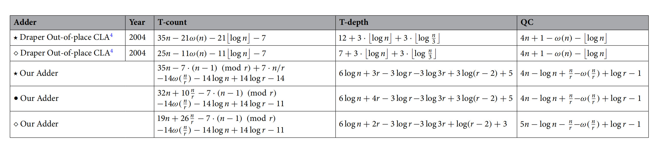
Results and Discussions

Slide 28
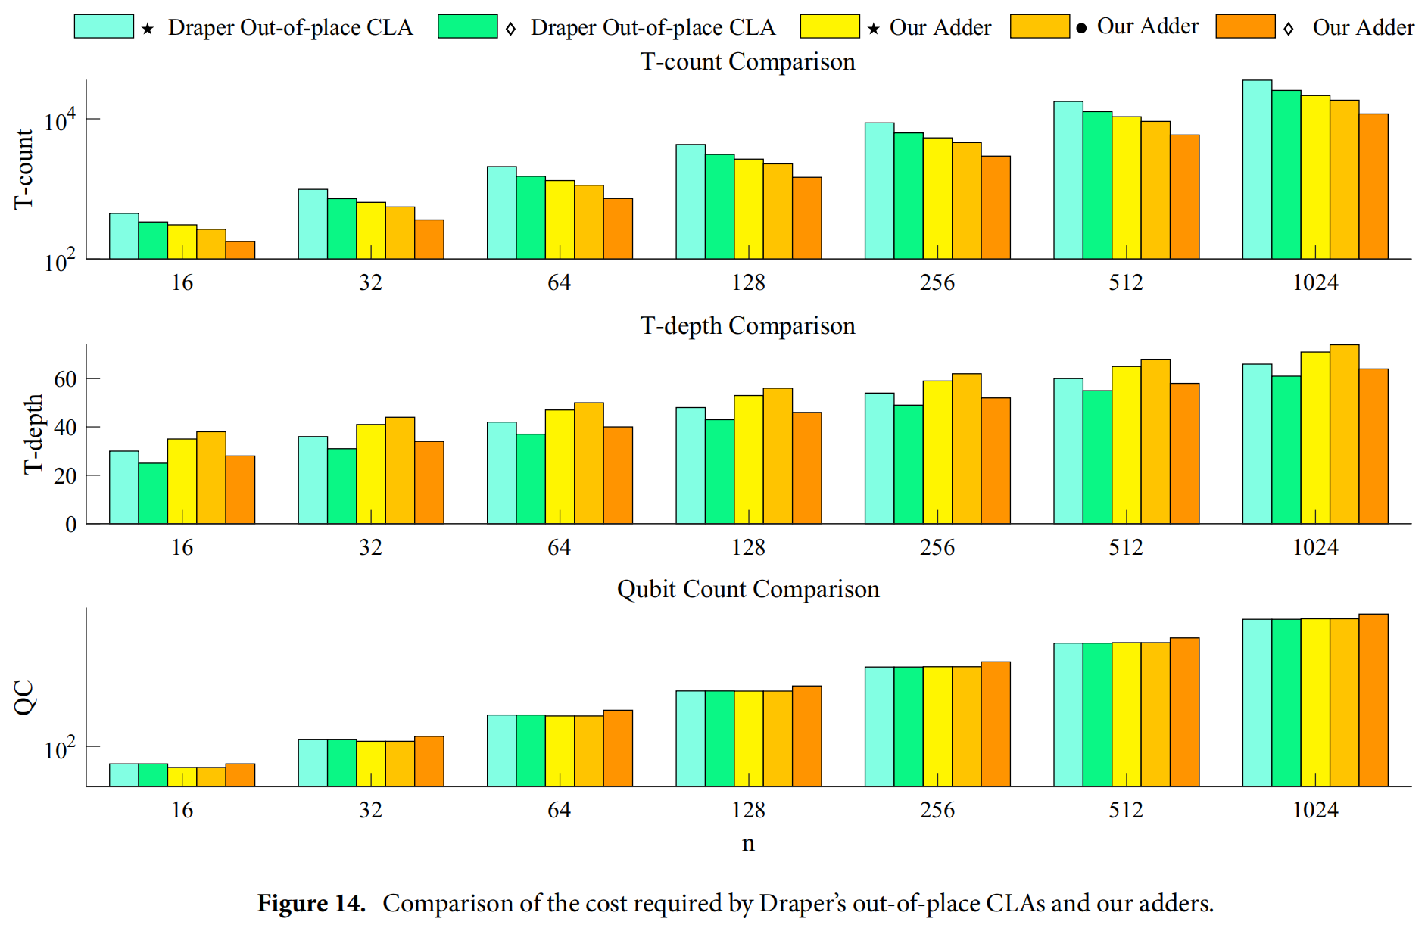

Slide 29
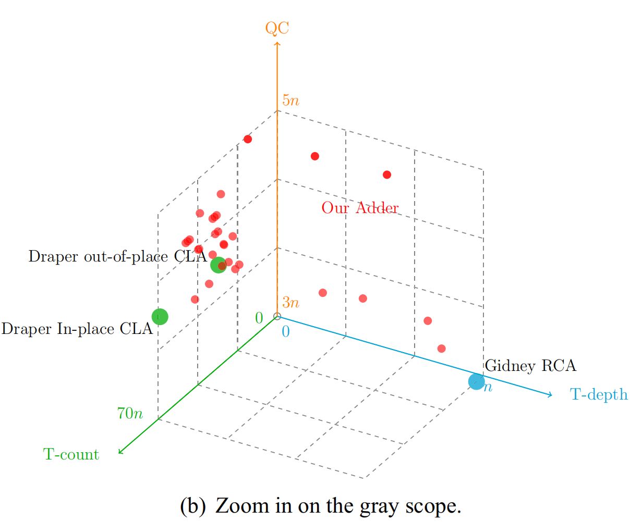
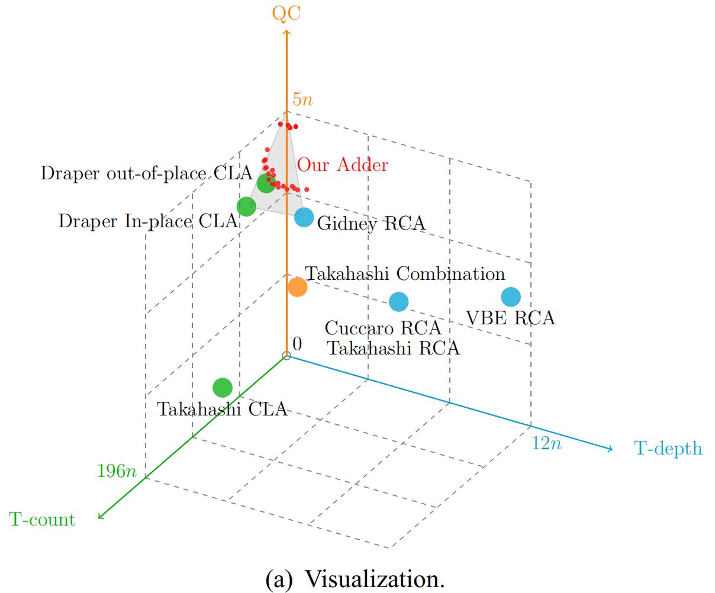
Results and Discussions
Visualization of quantum adders

Slide 30
Study 2
Quantum Ling Adder^{[6]}
S. Wang and A. Chattopadhyay, "Reducing Depth of Quantum Adder using Ling Structure," 2023 IFIP/IEEE 31st International Conference on Very Large Scale Integration (VLSI-SoC), Dubai, United Arab Emirates, 2023, pp. 1-6, doi: 10.1109/VLSI-SoC57769.2023.10321948.

Slide 31
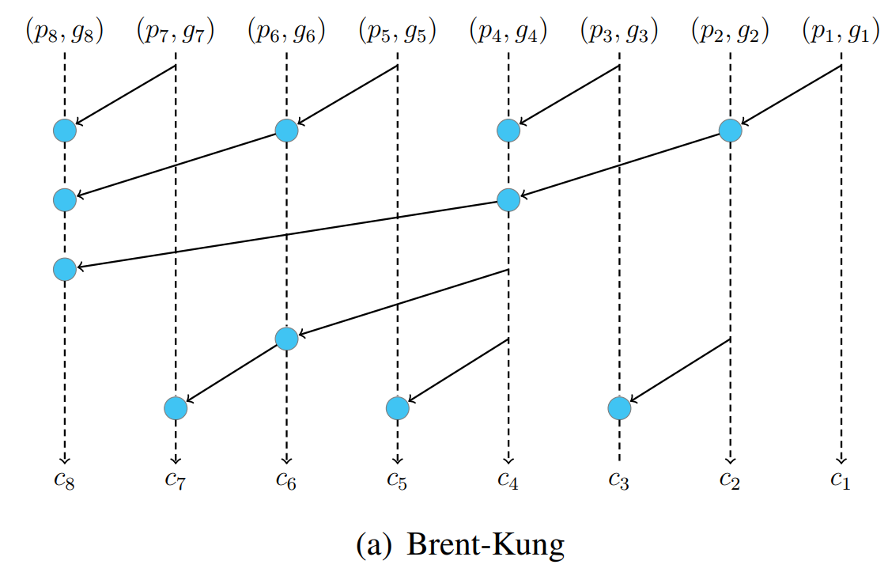
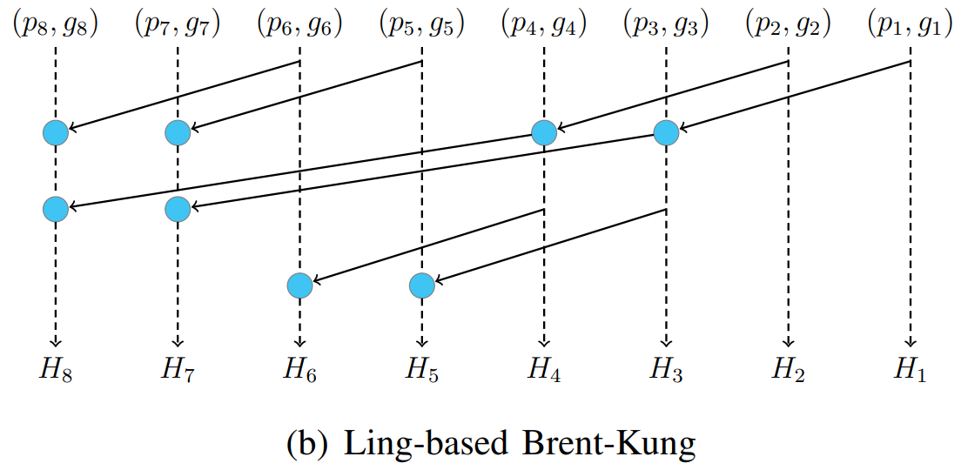
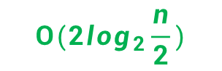
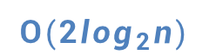
What is Ling strategy？
Ling structure can reduce T-depth sharply.
$$O({2log}_{2}n)$$
$$O(2\log_{2}\frac{n}{2})$$
5
3

Slide 32
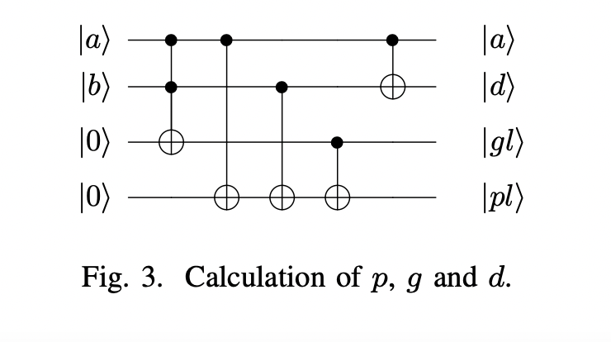
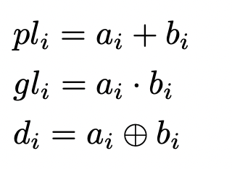
Step 1

Slide 33
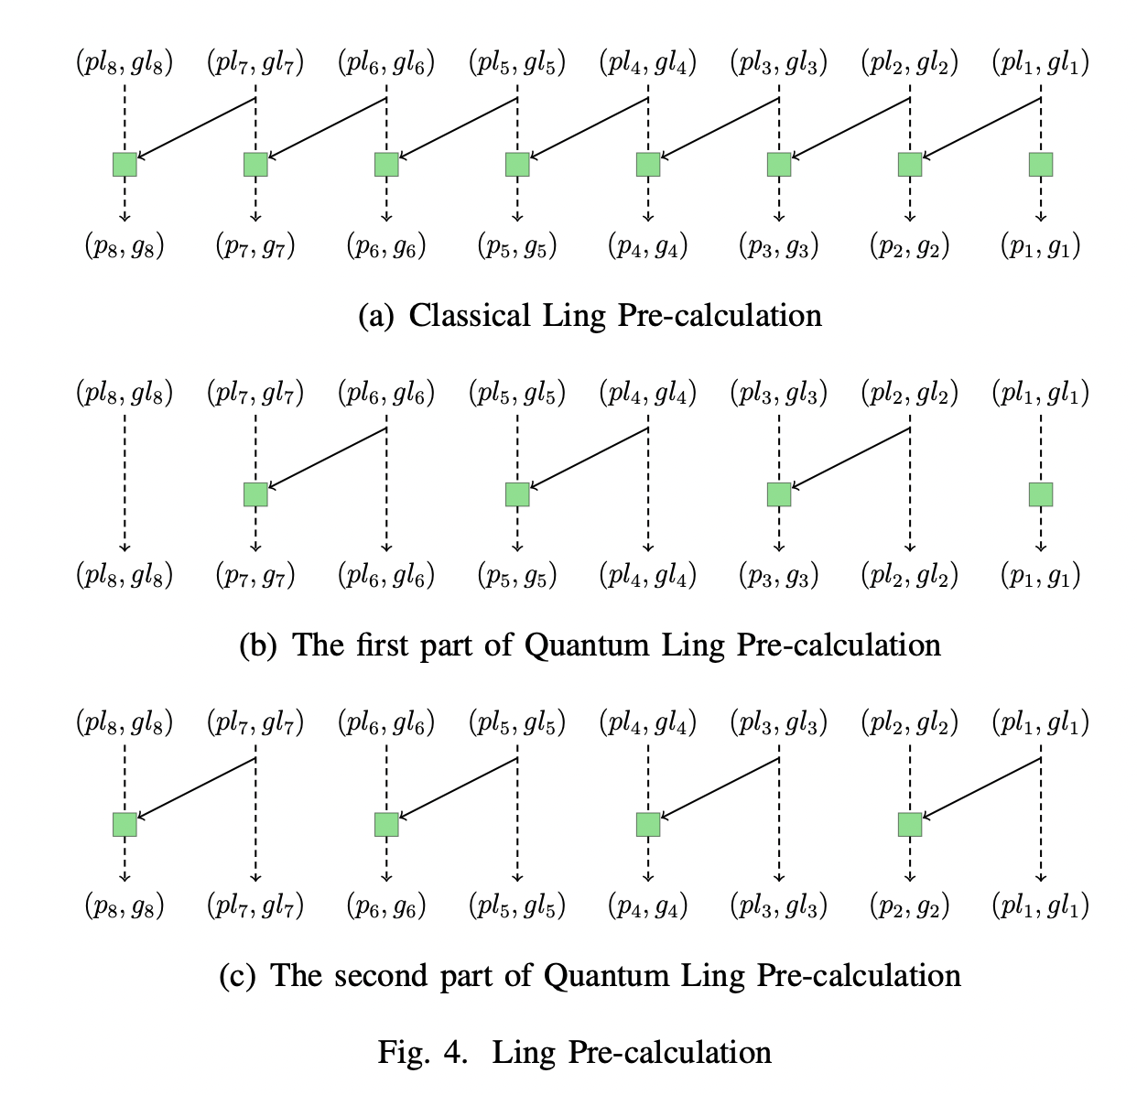
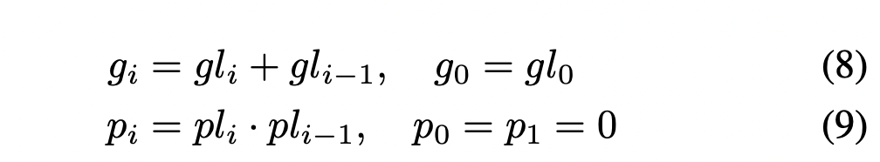
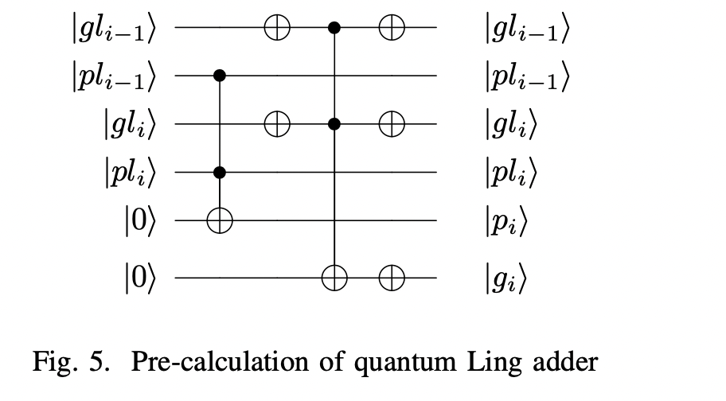
Step 2
Pre-calculation

Slide 34
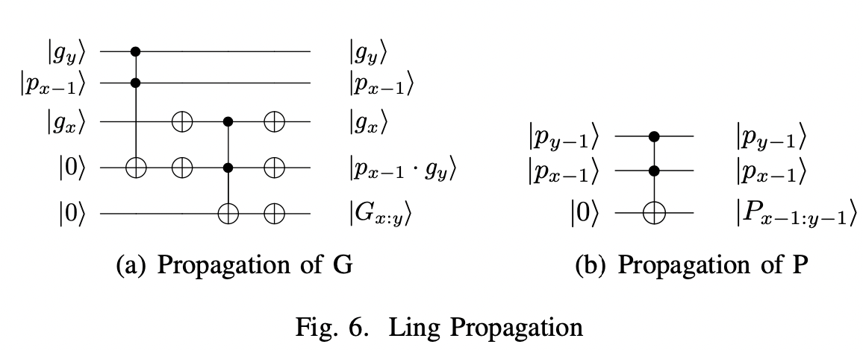
Step 3
Propagation

Slide 35
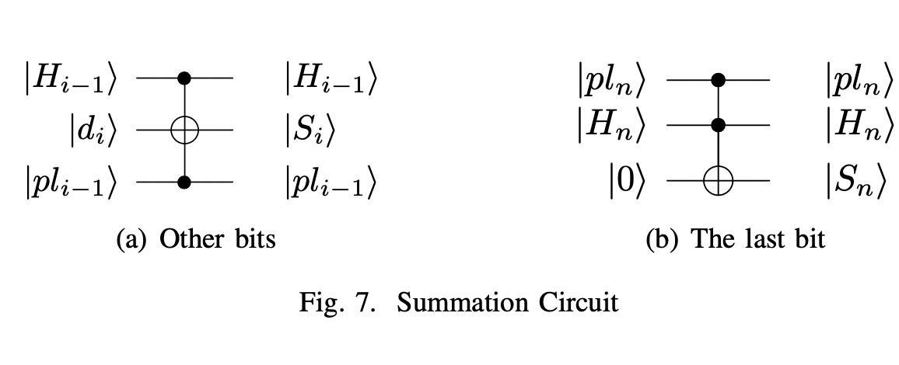
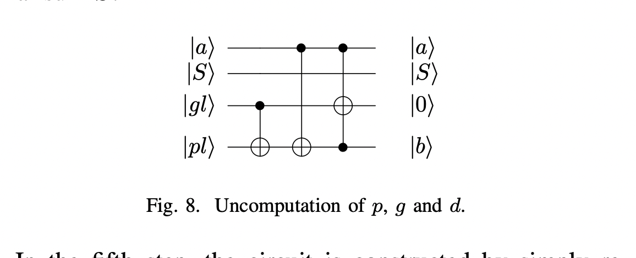
Step 4
Sum
Step 5, 6
Uncomputation

Slide 36
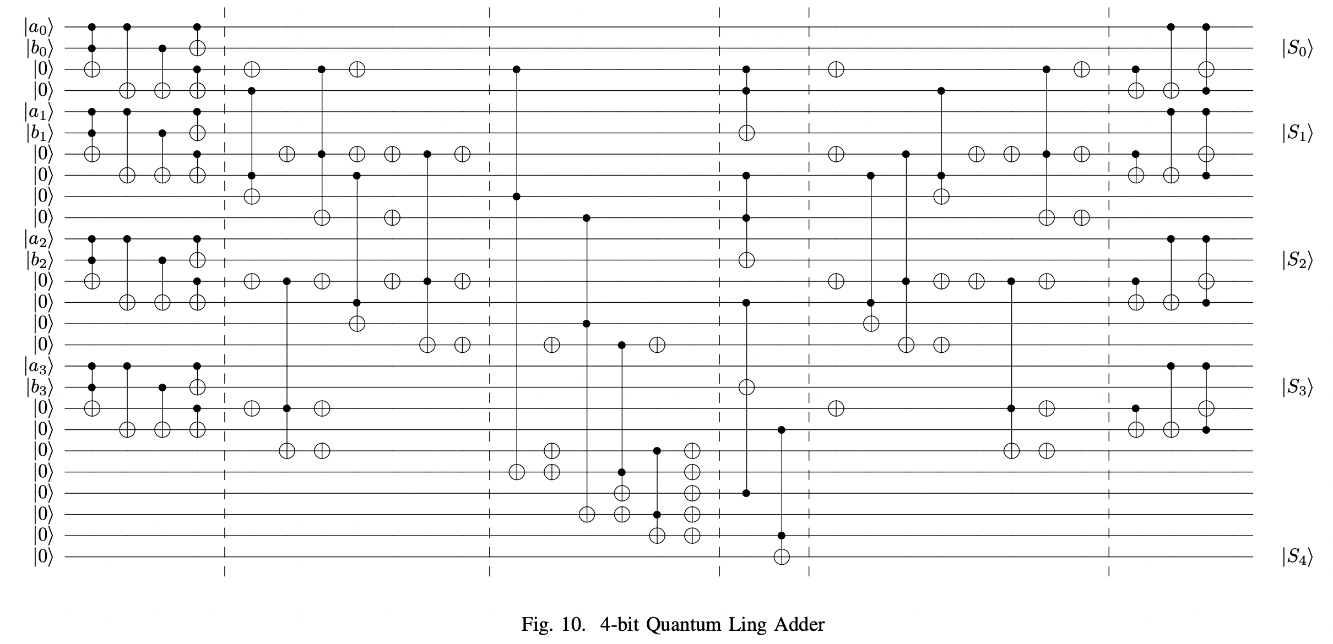
Overall Structure

Slide 37
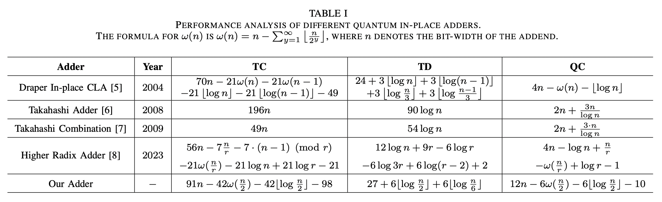
Results and Discussions

Slide 38
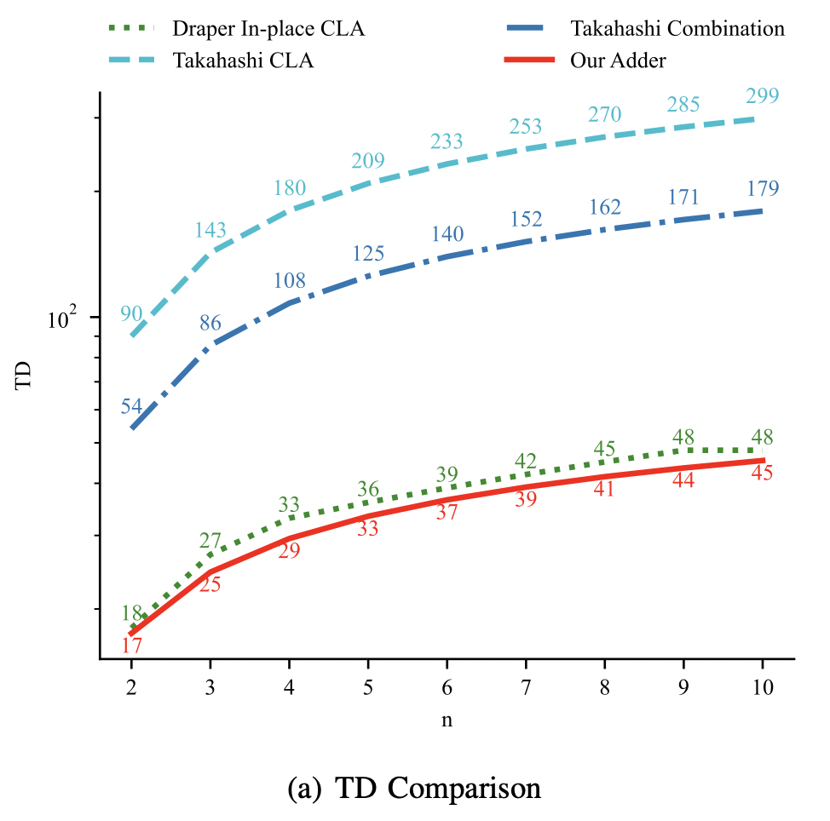
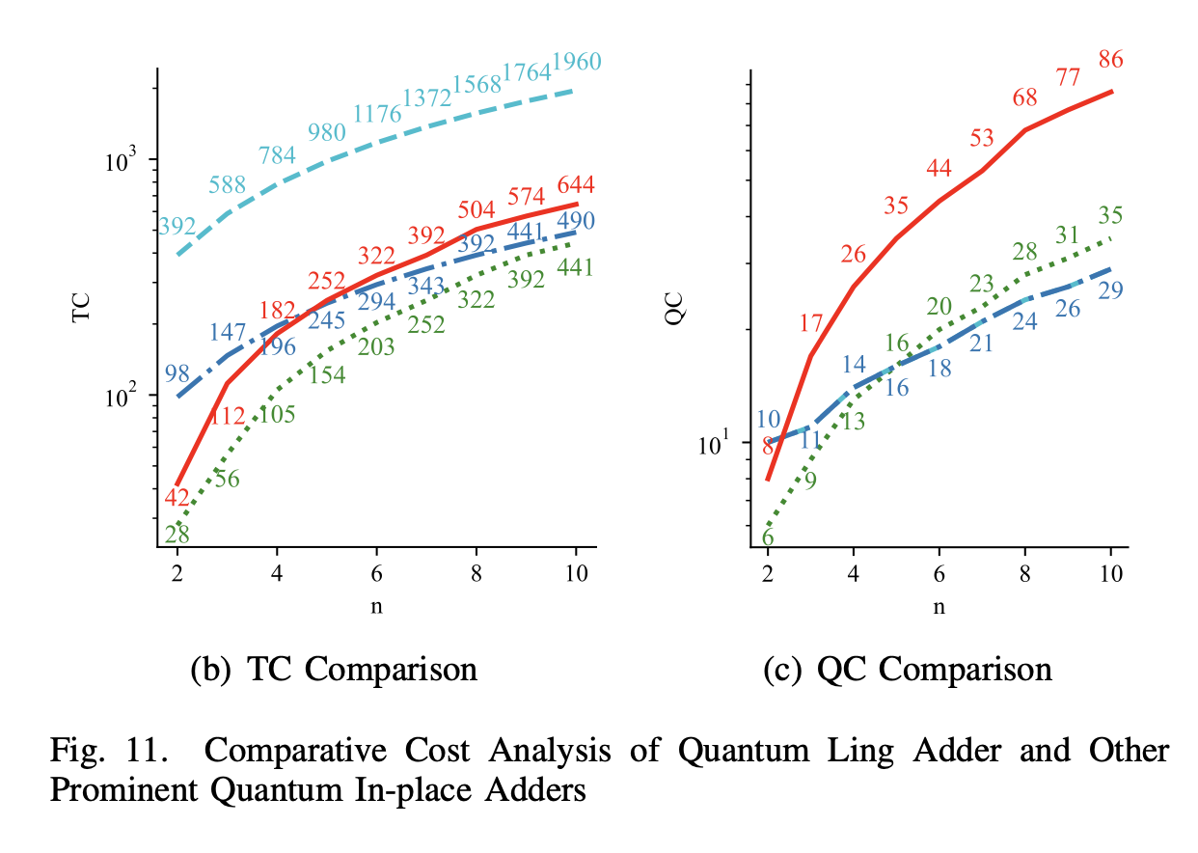
Results and Discussions

Slide 39
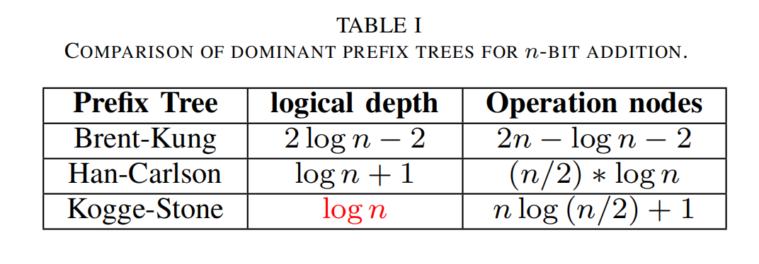
Study 3
Quantum Kogge-Stone Adder

Slide 40
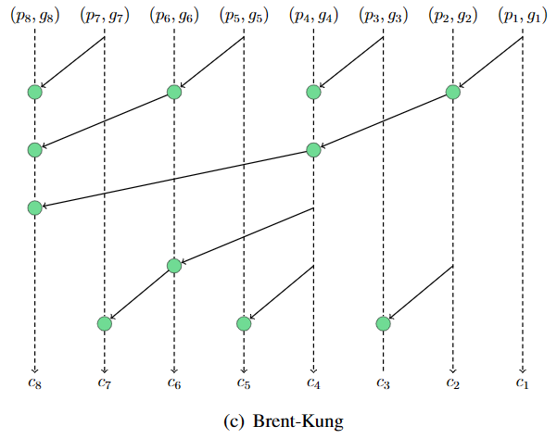
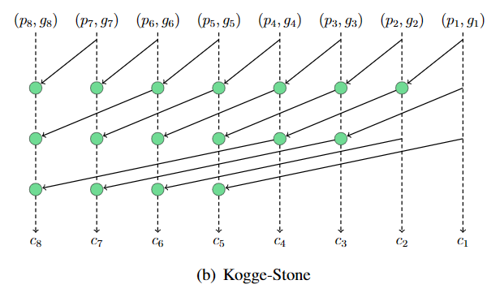


What is Kogge-Stone strategy？
The Kogge-Stone Adder achieves the lowest T-depth.
$$O({2log}_{2}n)$$
$$O(\log_{2}n)$$
5
3

Slide 41
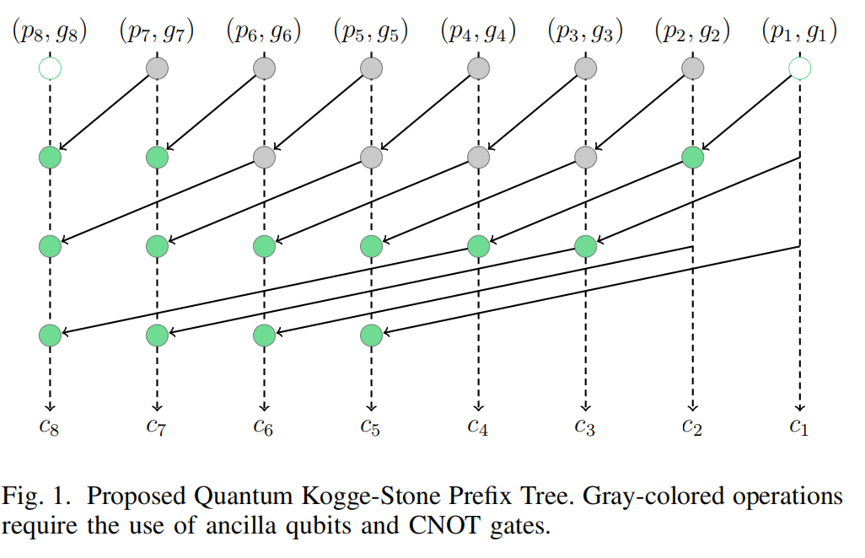
Methodology

Slide 42
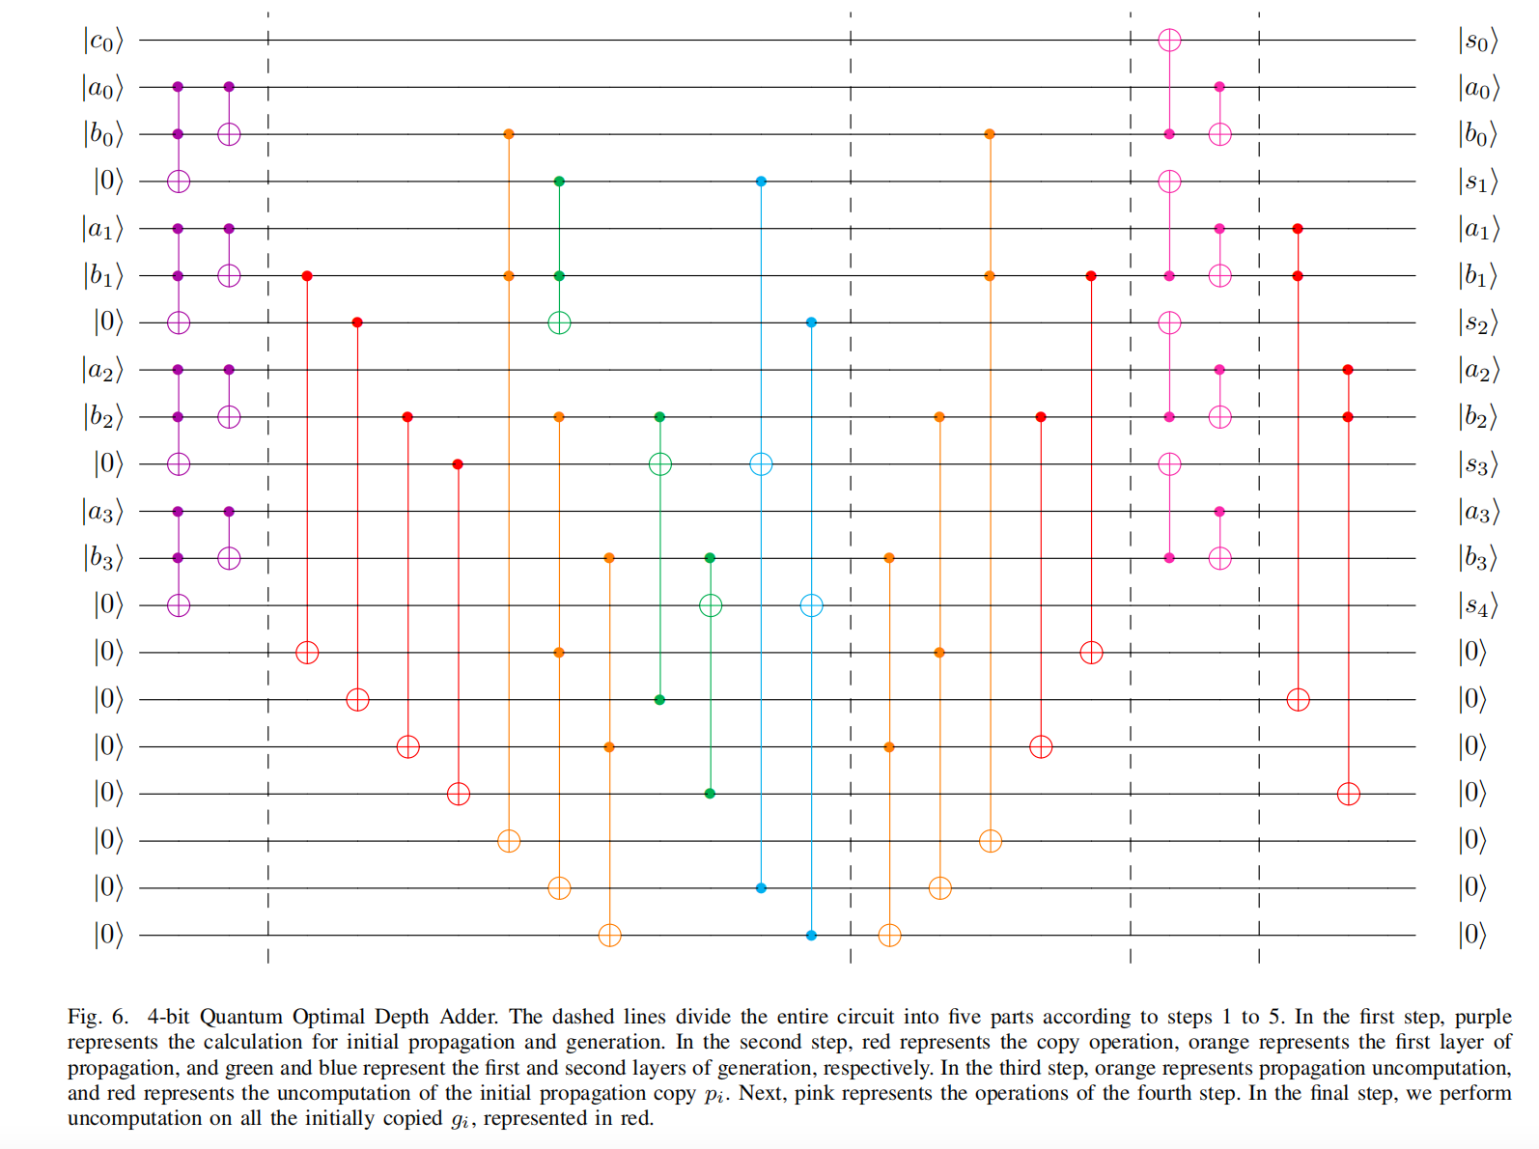
Overall Structure

Slide 43
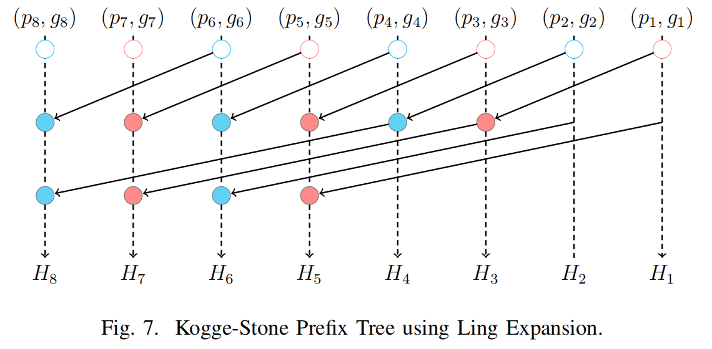
Ling Extension

Slide 44
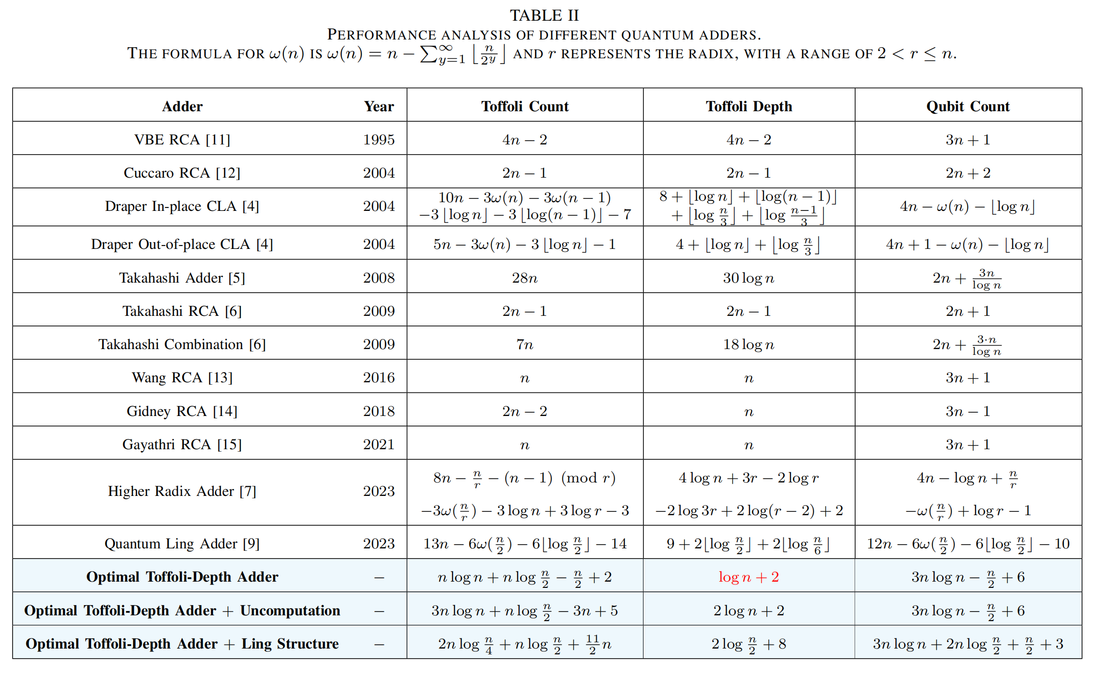
Results and Discussions

Slide 45
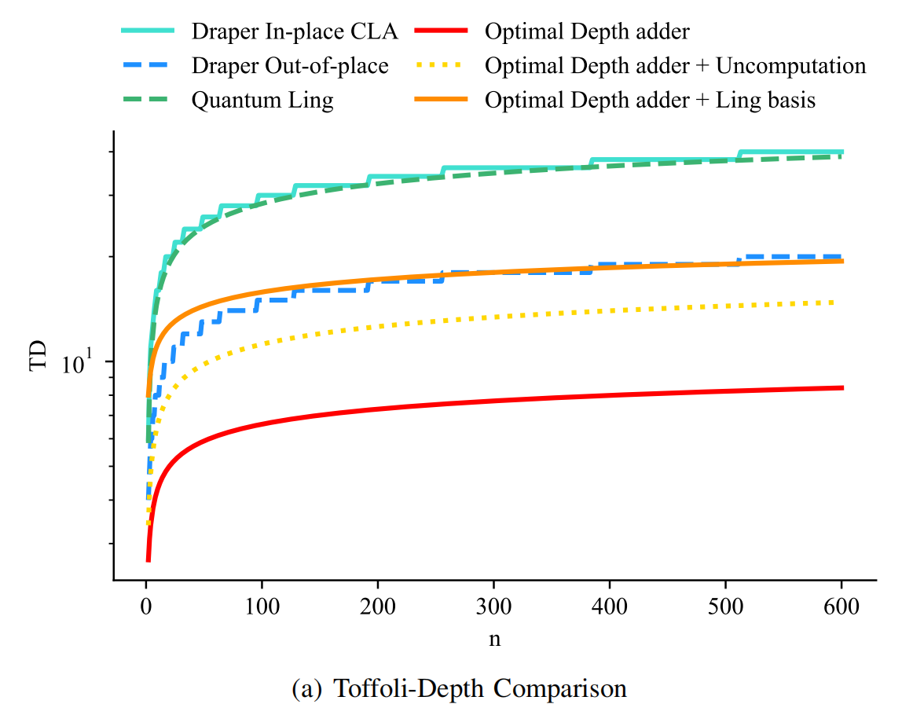

Results and Discussions

Slide 46
04
Quantum Division

Slide 47
Study 4
Quantum Non-Restoring Divider^{[7]}
Siyi Wang, Eugene Lim and Anupam Chattopadhyay, "Boosting the Efficiency of Quantum Divider through Effective Design Space Exploration" Accepted in 2024 The IEEE International Symposium on Circuits and Systems (ISCAS)

Slide 48


Methodology

Slide 49



Slide 50

Results and Discussions

Slide 51



Results and Discussions

Slide 52

Results and Discussions

Slide 53
05
Future Plan

Slide 54

Future Plan
➔
Quantum
Arithmetic Circuits
Quantum
Machine Learning
QML
Aimed at achieving a comprehensive exploration of the quantum domain from bottom to top.
Q Arithmetic

Slide 55
2023-2024: Exploration of Quantum Arithmetic
Design and Optimization of Quantum Modular Adders and Quantum Carry-Save Modular Adders
Approximate Division in Quantum Arithmetic Circuits
Quantum Malware Attack
2024-2025: Transition to Quantum Machine Learning
Quantum Multiplier Design
Error correction of quantum arithmetic circuits and mapping on real quantum computers
A Comprehensive Study of Quantum Arithmetic Circuits
2025-2026: Exploration of Quantum Machine Learning
Activation Functions in Quantum Machine Learning
Other Quantum Machine Learning work

Slide 56
06
Q&A

Slide 57
Q&A Thank you for listening!

Slide 58
References
[1]Vedral, V., Barenco, A., & Ekert, A. (1996). Quantum networks for elementary arithmetic operations. Physical Review A, 54(1), 147.
[2]Cuccaro, S. A., Draper, T. G., Kutin, S. A., & Moulton, D. P. (2004). A new quantum ripple-carry addition circuit. arXiv preprint quant-ph/0410184.
[3]Draper, T. G., Kutin, S. A., Rains, E. M., & Svore, K. M. (2004). A logarithmic-depth quantum carry-lookahead adder. arXiv preprint quant-ph/0406142.
[4]Gidney, C. (2018). Halving the cost of quantum addition. Quantum, 2, 74.
[5]Wang, S., Baksi, A. & Chattopadhyay, A. (2023).A Higher radix architecture for quantum carry-lookahead adder. Sci Rep 13, 16338.
[6]S. Wang and A. Chattopadhyay. (2023).Reducing depth of quantum adder using ling structure. VLSI-SoC, 2023.

Slide 59
References
[7]S. Wang, E. Lim and A. Chattopadhyay. (2024).Boosting the Efficiency of Quantum Divider through Effective Design Space Exploration. ISCAS, 2024.
[8]Thomas G. Draper. “Addition on a Quantum Computer”. In: (Aug. 2000). arXiv:
quant-ph/0008033.
[9]D.L. Harris, Stuart Oberman, and M.A. Horowitz. “SRT division architectures and implementations”. In: Aug. 1997, pp. 18–25. isbn: 0-8186-7846-1. doi: 10.1109/ARITH.1997.614875.
[10]David Harris, Stuart Oberman, and Mark Horowitz. “SRT Division: Architectures,Models, and Implementations”. In: (Dec. 2001).
[11]Liang Fang and Lin Pang. “Improved Newton-Raphson Methods for Solving Nonlinear Equations”. In: JOURNAL OF ADVANCES IN MATHEMATICS 13 (Dec. 2017),pp. 7403–7407. doi: 10.24297/jam.v13i5.6533.

Slide 60
References
[12]Robert E Goldschmidt. “Applications of division by convergence”. PhD thesis. Massachusetts Institute of Technology, 1964.
[13]Alireza Khosropour, Hossein Aghababa, and Behjat Forouzandeh. “Quantum Division Circuit Based on Restoring Division Algorithm”. In: Apr. 2011, pp. 1037–1040. doi:10.1109/ITNG.2011.177.
[14]Himanshu Thapliyal et al. “Quantum Circuit Designs of Integer Division Optimizing T-Count and T-Depth”. In: 2017 IEEE International Symposium on Nanoelectronic and Information Systems (iNIS). 2017, pp. 123–128. doi: 10.1109/iNIS.2017.34.
[15]Himanshu Thapliyal et al. “Quantum Circuit Designs of Integer Division Optimizing T-count and T-depth”. In: IEEE Transactions on Emerging Topics in Computing 9.02 (Apr. 2021), pp. 1045–1056. issn: 2168-6750. doi: 10.1109/TETC.2019.2910870.

Slide 61
References
[16]Mathias Soeken et al. “Design automation and design space exploration for quantum computers”. In: Design, Automation and Test in Europe Conference and Exhibition (DATE), 2017. 2017, pp. 470–475. doi: 10.23919/DATE.2017.7927035.
[17]S S Gayathri, R. Kumar, and Samiappan Dhanalakshmi. “Efficient Floating-point
Division Quantum Circuit using Newton-Raphson Division”. In: Journal of Physics:
Conference Series 2335.1 (Sept. 2022), p. 012058. doi: 10.1088/1742-6596/2335/1/012058. url: https://dx.doi.org/10.1088/1742-6596/2335/1/012058.
[18]S S Gayathri et al. “T-Count Optimized Quantum Circuit Designs for Single-Precision Floating-Point Division”. In: Electronics 10 (Mar. 2021), p. 703. doi: 10 . 3390 / electronics10060703.

